Slide 1



High Availability with miSecureMessages
6/8/2023 1:00 PM CDT
Presented by: Adam Haines/Senior Client Systems Architect
Hosted by: Gloria Fruit/Director for Software, Research and Development

Slide 2

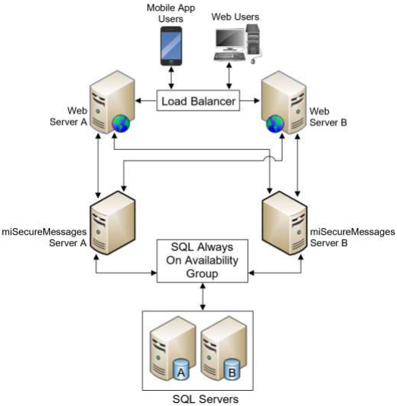

High Availability and miSecureMessages
Please note: Cloud-based MSM configurations are maintained by Amtelco and includes HA as part of the infrastructure.
HA application proxy support starts on MSM server release 6.8.
https://support.amtelco.com/system/files/MSM/KnowledgeBase/MSM_HighAvailability.pdf

Slide 3

What is High Availability (HA)?
High availability (HA) is a characteristic of a system which aims to ensure an agreed level of operational performance, usually uptime, for a higher-than-normal period.

Slide 4

Principals of High Availability
There are three principles of systems design in reliability engineering which can help achieve high availability.
Elimination of single points of failure. This means adding or building redundancy into the system so that failure of a component does not mean failure of the entire system.
Reliable crossover. In redundant systems, the crossover point itself tends to become a single point of failure. Reliable systems must provide for reliable crossover.
Detection of failures as they occur. If the two principles above are observed, then a user may never see a failure, but the maintenance activity must.

Slide 5

Server Types In HA Configuration
Application
SQL
Web - External
Web - Internal (Optional)
***Server types can be shared between miSecureMessages and Intelligent Series***

Slide 6
Application
Two servers required.
Both servers have application proxy running.
HA is controlled and achieved via the MSM application proxy.

Slide 7
Web - External
Two servers, minimum, required.
HA is controlled and achieved via network load balancer.
MSM Web Service (required), MSM Client Web (optional), MSM Admin (optional).
Web applications have both MSM application servers programmed.

Slide 8
Web – Internal (Optional)
If MSM Admin and MSM Client Web must only be reachable internally.
Two servers, minimum, required.
HA is controlled and achieved via network load balancer.
MSM Admin Web (optional), MSM Client Web (optional).
Web applications have both MSM application servers programmed.

Slide 9

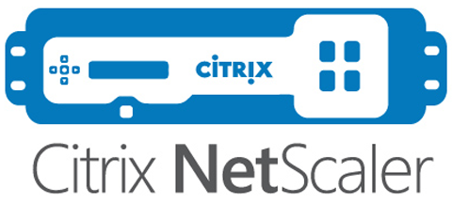

Network Load Balancer
Load balancing is the method of distributing network traffic equally across a pool of resources that support an application.
miSecureMessages supports multiple types of load balancers to achieve high availability.
Session persistence is required.

Slide 10
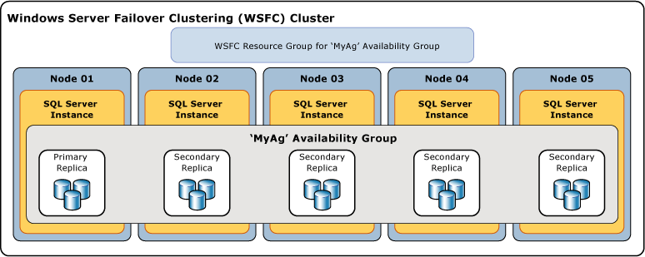
SQL
SQL Always On Availability Groups highly recommended to achieve HA.
Synchronous-commit replicas highly recommended.
Two servers, minimum, required (most common). Maximum of four synchronous-commit replicas supported.
Servers must be deployed with the same Windows OS and SQL versions (Version minimum 2016, 2019 preferred.
Cloud Platform as a Service (PaaS) Options.

Slide 11
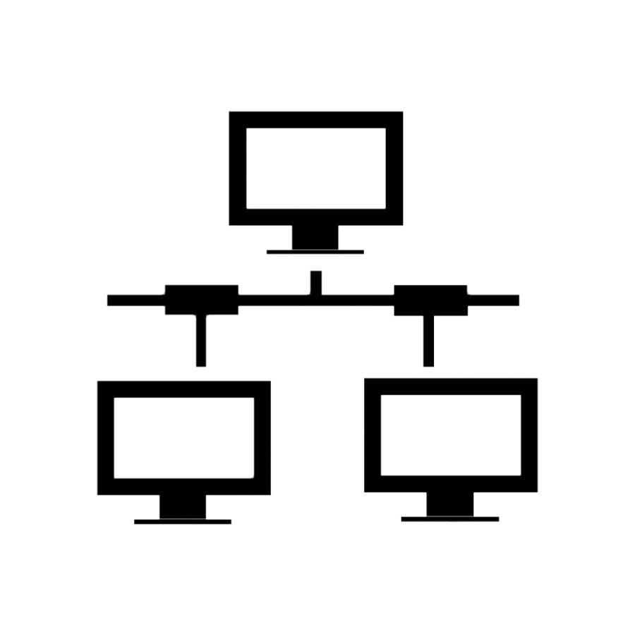
Network High Availability
Internal and external (Internet) network high availability is strongly encouraged, specifically networking components such as switches, routers, and ISPs.

Slide 12

Questions?

Slide 13

Thank You!

