Slide 1



Single Sign-On (SSO) with miSecureMessages
4/6/2023 1:00 PM CDT
Presented by: Adam Haines/Senior Client Systems Architect
Hosted by: Gloria Fruit/Director for Software, Research and Development

Slide 2





What is Single-Sign On (SSO)?
Single sign-on (SSO) is an authentication method that enables users to securely authenticate with multiple applications and websites by using just one set of credentials.
Support starts on MSM server release 6.8.

Slide 3

Advantages/Disadvantages
Advantages
  SSO allows users to access applications and accounts much more quickly and with less hassle.
  Users only need to remember one set of credentials, such as a username and a single password.
  Services that utilize SSO may spend much less time helping users with lost passwords.
  Administrators can centralize control over user access to platforms and easily grant permissions for or remove permissions from users.
  Administrators can better enforce strong passwords and security standards across applications.
Disadvantages
  SSO can present security risks, as it only requires one set of credentials for access to multiple applications. Organizations can help mitigate this by requiring strong passwords from users.
  Implementing SSO can be a complex and costly project since a detailed discovery phase is necessary to ensure the right processes and technologies are implemented.
  If the SSO system goes down, users would lose access to all the applications that come under its umbrella rather than just a single site or service.
  If an SSO account is hacked, that bad actor would have access to all applications, thereby exposing a large amount of private data.

Slide 4



Types of SSO?
Federated Identity Management (FIM)
OAuth (v2.0)
OpenID Connect (OIDC)
Security Access Markup Language (SAML) (v2.0)
Same Sign On (SSO)
Amtelco only supports the SAML SSO type today.

Slide 5
What is SAML?
SAML is an acronym used to describe the Security Assertion Markup Language. Its primary role in online security is that it enables you to access multiple web applications using one set of login credentials. It works by passing authentication information in a particular format between two parties, usually an identity provider (IdP) and a web or client application.
SAML is an open standard used for authentication. Based upon the Extensible Markup Language (XML) format, web applications use SAML to transfer authentication data between two parties - the identity provider (IdP) and the service provider (SP).

Slide 6
What is a SAML Identity Provider (IdP)?
Customer Provided.
Examples of and IdPs tested by Amtelco: ADFS (Microsoft), Azure, and Ping Identity. Other examples include Okta, AWS Cognito, etc.
A SAML identity provider is a system entity that issues authentication assertions in conjunction with a single sign-on (SSO) profile of the Security Assertion Markup Language (SAML). In the SAML domain model, a SAML authority is any system entity that issues SAML assertions. Two important examples of SAML authorities are the authentication authority and the attribute authority.
A SAML authentication authority is a system entity that produces SAML authentication assertions. Likewise, a SAML attribute authority is a system entity that produces SAML attribute assertions.
A SAML authentication authority that participates in one or more SSO Profiles of SAML is called a SAML identity provider (or simply identity provider if the domain is understood). For example, an authentication authority that participates in SAML Web Browser SSO is an identity provider that performs the following essential tasks:
*Receives a SAML authentication request from a relying party via a web browser.
*Authenticates the browser user principal.
*Responds to the relying party with a SAML authentication assertion for the principal.
In the previous example, the relying party that receives and accepts the authentication assertion is called a SAML service provider.
A given SAML identity provider is described by an <md:IDPSSODescriptor> element defined by the SAML metadata schema. Likewise, a SAML service provider is described by an <md:SPSSODescriptor> metadata element.
In addition to an authentication assertion, a SAML identity provider may also include an attribute assertion in the response. In that case, the identity provider functions as both an authentication authority and an attribute authority.

Slide 7
What is a SAML Service Provider?
Amtelco provided in the form of a web app.
Installed on a web server preferably load balanced between two web servers.
A SAML service provider is a system entity that receives and accepts authentication assertions in conjunction with a single sign-on (SSO) profile of the Security Assertion Markup Language (SAML).
In the SAML domain model, a SAML relying party is any system entity that receives and accepts information from another system entity. Of particular interest is a SAML relying party that receives and accepts a SAML assertion issued by a SAML authority.
An important type of SAML authority is the SAML identity provider, a system entity that issues authentication assertions in conjunction with an SSO profile of SAML. A relying party that consumes such assertions is called a SAML service provider (or simply service provider if the domain is understood). A SAML service provider is a system entity that receives and accepts an authentication assertion issued by a SAML identity provider.

Slide 8
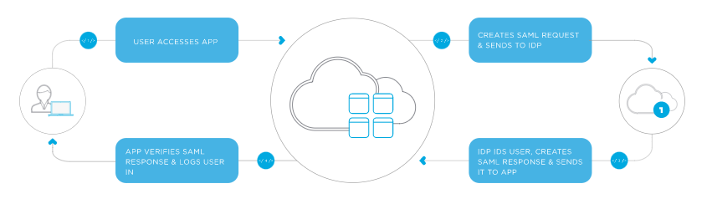
How Does SAML Work?
SAML SSO works by transferring the user’s identity from one place (the identity provider) to another (the service provider). This is done through an exchange of digitally signed XML documents.
The user accesses the remote application using a link on an intranet, a bookmark, or similar and the application loads.
The application identifies the user’s origin (by application subdomain, user IP address, or similar) and redirects the user back to the identity provider, asking for authentication. This is the authentication request.
The user either has an existing active browser session with the identity provider or establishes one by logging into the identity provider.
The identity provider builds the authentication response in the form of an XML-document containing the user’s username or email address, signs it using an X.509 certificate, and posts this information to the service provider.
The service provider, which already knows the identity provider and has a certificate fingerprint, retrieves the authentication response and validates it using the certificate fingerprint.
The identity of the user is established, and the user is provided with app access.

Slide 9
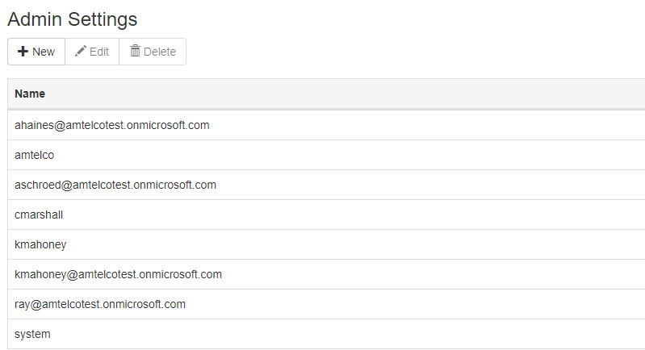
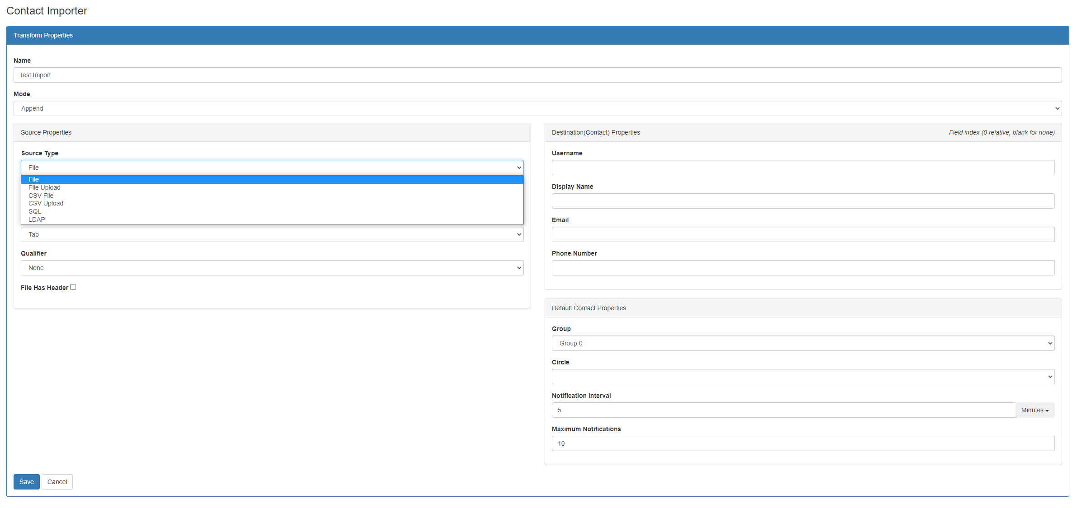
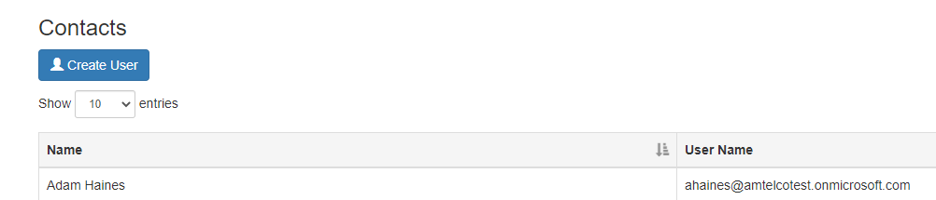
MSM Admins/Contacts
SSO usernames are typically set up with in the UPN attribute (email format), but are not required to be (sAMAccountName, etc.).
Contacts can be created manually or imported via the MSM transform tool and must match the chosen SSO username attribute. When using SSO, admin users and contact users must be set with blank passwords.
The MSM transform tool supports importing from multiple source types, including LDAP for a more seamless AD integration.
For existing MSM customers integrating with SSO, your admin and contact usernames MUST match your chosen SSO username attribute. Non-matching users/contacts will need to be rebuilt.

Slide 10
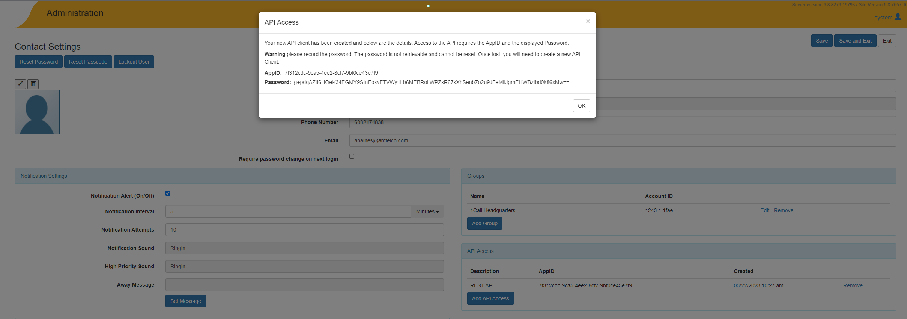
MSM REST API Support With SSO
If using the MSM REST API, an MSM Contact is still required, but you will also need to create an API Access Client that will automatically generate an AppID and AppSecret from via the MSM Admin.
Amtelco recommends using a POST routine for the Login method instead of GET routine as POST routines encrypt the AppID and AppSecret values whereas GET routines keep the AppID and AppSecret values in plain text in the URL.

Slide 11

SSO Planning Checklist
Review MSM SSO documentation.
Choose an Identity Provider.
  Configure IdP for MSM.
  Export or copy metadata to create X.509 type SSL certificate. Some IdPs allow exporting the cert directly.
  Import IdP SSL certificate on web server(s) where Service Provider website(s) is/are running.
  Decide if you will require MFA. This is programmed on the IdP side.
Install and configure Service Provider website.
  Amtelco assistance provided.
  Import Service Provider SSL certificate. This would be your typical domain wildcard or named cert.
  Configure saml.config and web.config.
New customers: Create/import MSM Admin and Contact users.
Existing customers: Ensure your MSM Admin and Contact users match your chosen SSO attribute.
Program SSO Assertion URL in the MSM Admin (Configuration at the system level, Groups at a per Group level).
Enable SSO.
*Customers are solely responsible for providing, maintaining, and renewing all SSL certificates.

Slide 12
SSO Demo
Saml.config.
IdP example.
Client apps SSO login process.

Slide 13
Thank you!
Any questions?

