Slide 1

Active Insights Custom Dashboard
Presented by: Connor La Favor & Jayce Jerabek
July 2025

Slide 2

Agenda
General terminology; definitions
How to create/edit a dashboard
Useful widgets
Optimization of data

Slide 3


General Terminology
Tab
Panel
Widget
Filters

Slide 4
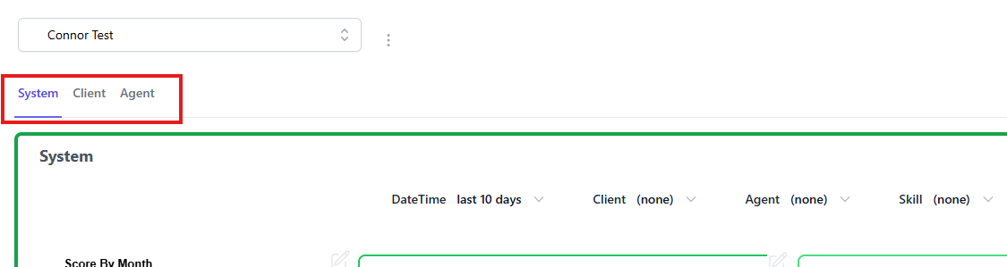
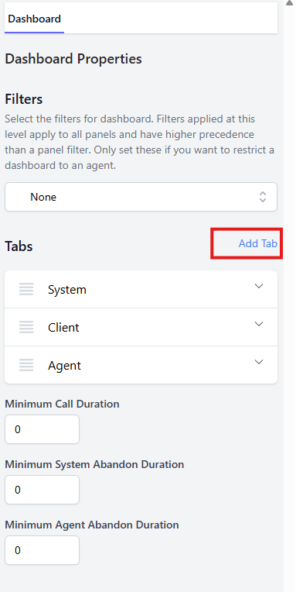
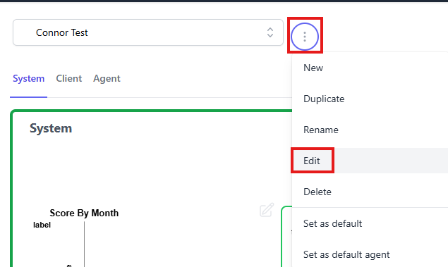
Tabs
Think of tabs as different "Pages"
To create/edit your tabs begin by editing the dashboard
Use the blue "Add Tab" to create as many tabs as need for your dashboard

Slide 5
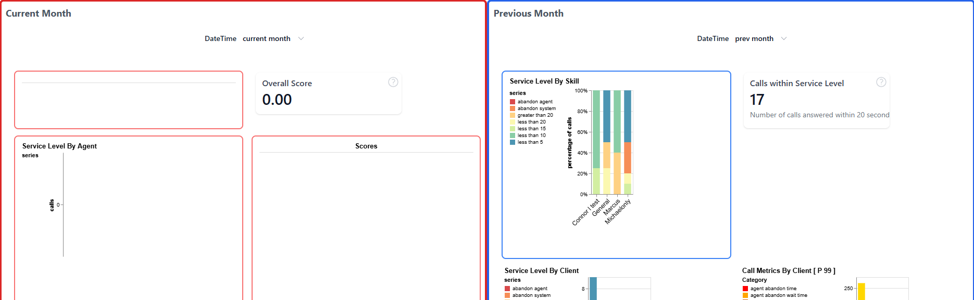
Panels
Panels are areas within your various tabs
Use Panels to divide up your data as you see fit
You can size your panels so that they are side by side or over/under
You may also use colors to help divide your panels

Slide 6
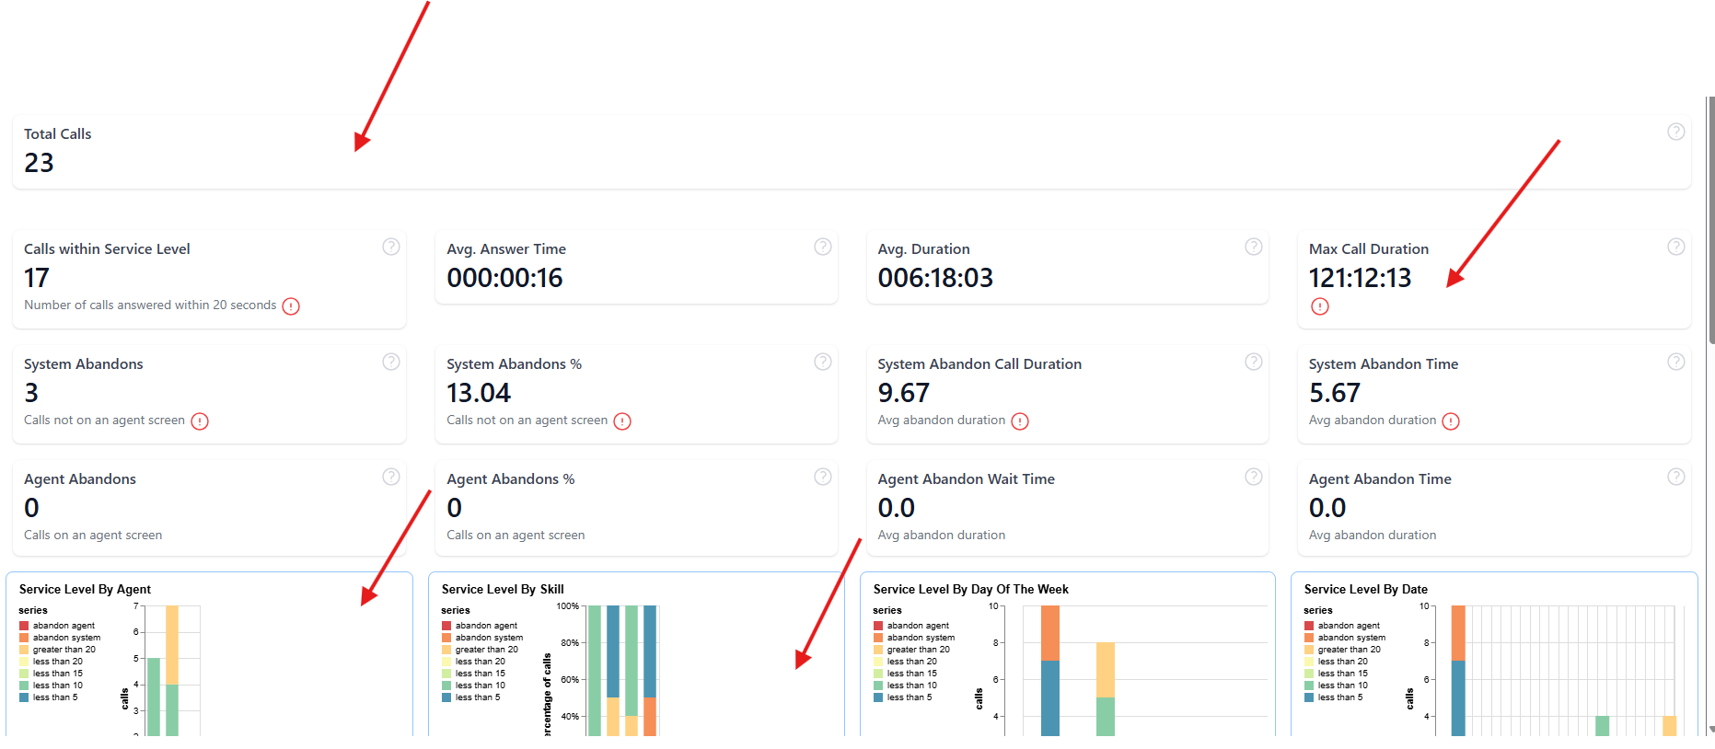
Widgets
Widgets go within your Panels and are what actually displays the data!
You can control which Widgets go within which Panels
You can also give the widgets different sizes and colors similar to the Panels to best optimize the data you are trying to display

Slide 7
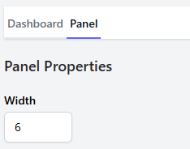
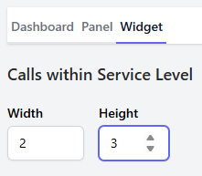
Sizing of Widgets/Panels
Height and Width
("12" is the max width you can enter for a panel and/or widget)
(Height is technically no limit, depends how many widgets you have in your panels)
(Widgets do have a max height of 8)

Slide 8
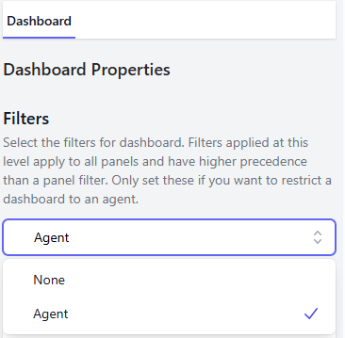
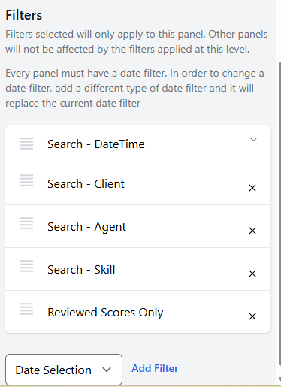
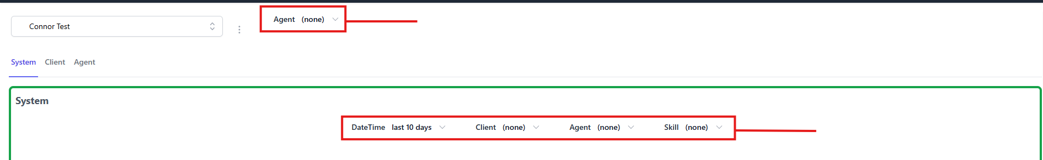
Filters
Can be used at the Dashboard (Tabs) and Panel level
Dashboard only has an "Agent" filter
Reasons for having different filters on multiple panels
Dashboard Filter
Panel Filter

Slide 9
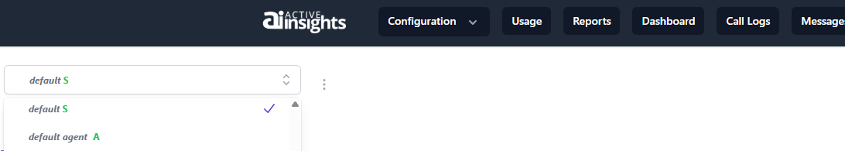
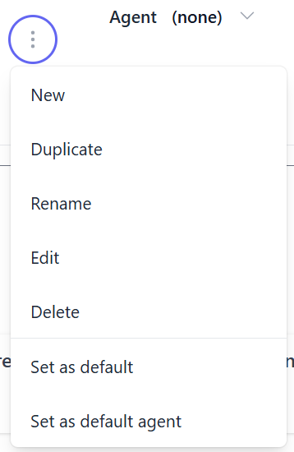
Creating your Dashboard
Dashboard Tab -> three dots
Defaults
Italics – Amtelco default
S – Default System dashboard
A – Default Agent dashboard
You cannot edit Amtelco's default dashboards;
You can (and are encouraged to!) set your custom dashboard as default.

Slide 10
Creating your Dashboard
Amtelco recommends Duplicating dashboards instead of creating New ones.
Adding New dashboards is more complicated and generally recommended for experienced users of Active Insights.
Most default widgets you'd duplicate are those you would likely use regardless.

Slide 11
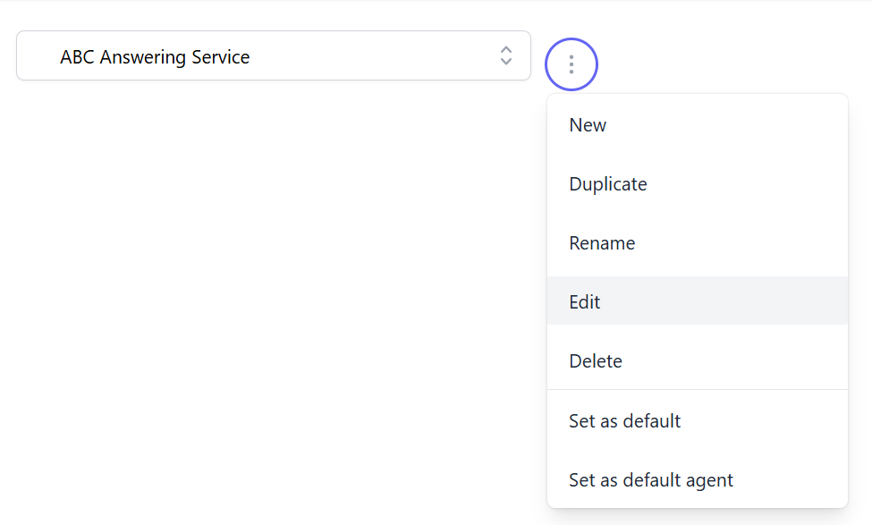
Editing your Dashboard
Dashboard to edit -> Three dots

Slide 12
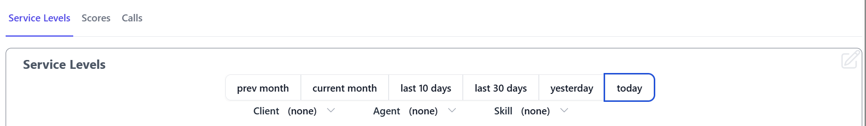
Editing your Dashboard
Most edits you'll be making will be at the panel level:
Adding widgets
Setting filters
When in Edit mode, you'll see a faint gray pencil icon on a given panel. Click to edit that panel.
If you don't see the pencil, make sure you've clicked the three dots to be in Edit mode.

Slide 13
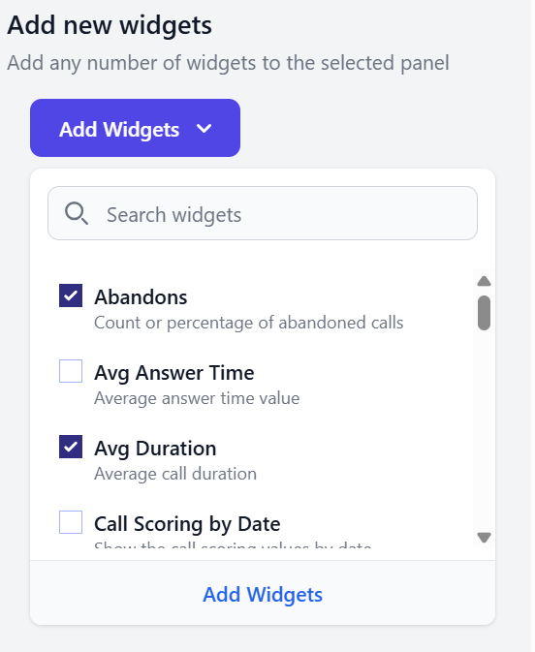
Editing your Panel
From here, you can add, remove, and re-order widgets
Enable or disable filters
Make cosmetic changes to your panel, such as border color and thickness
Efficiency tip! You want your information to be visible at-a-glance. The more stuff you have on screen, the less useful your dashboard is at saving you time. Amtelco recommends 1-3 relatively simple panels per dashboard.
One section of the Panel sidebar

Slide 14
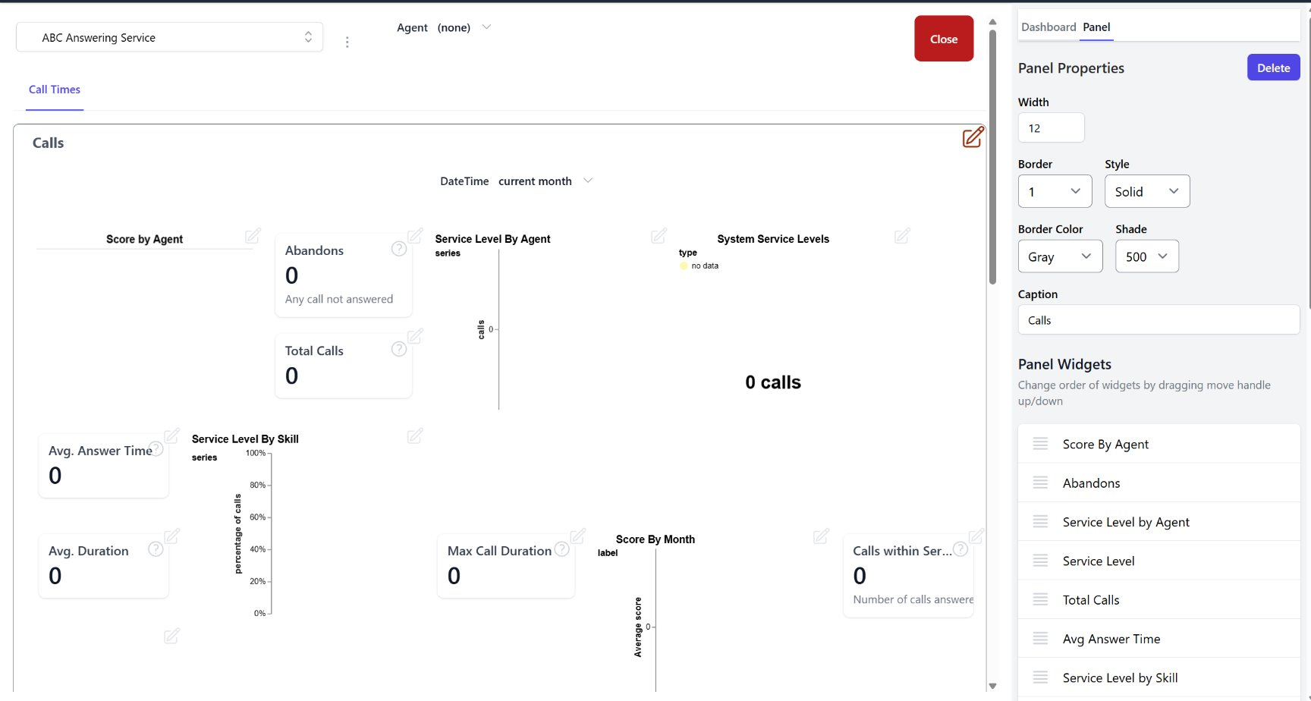

Reordering Widgets

Slide 15
Reordering Widgets
Newly added widgets may initially be organized strangely. Drag the widgets up and down on the sidebar to re-order.

Slide 16
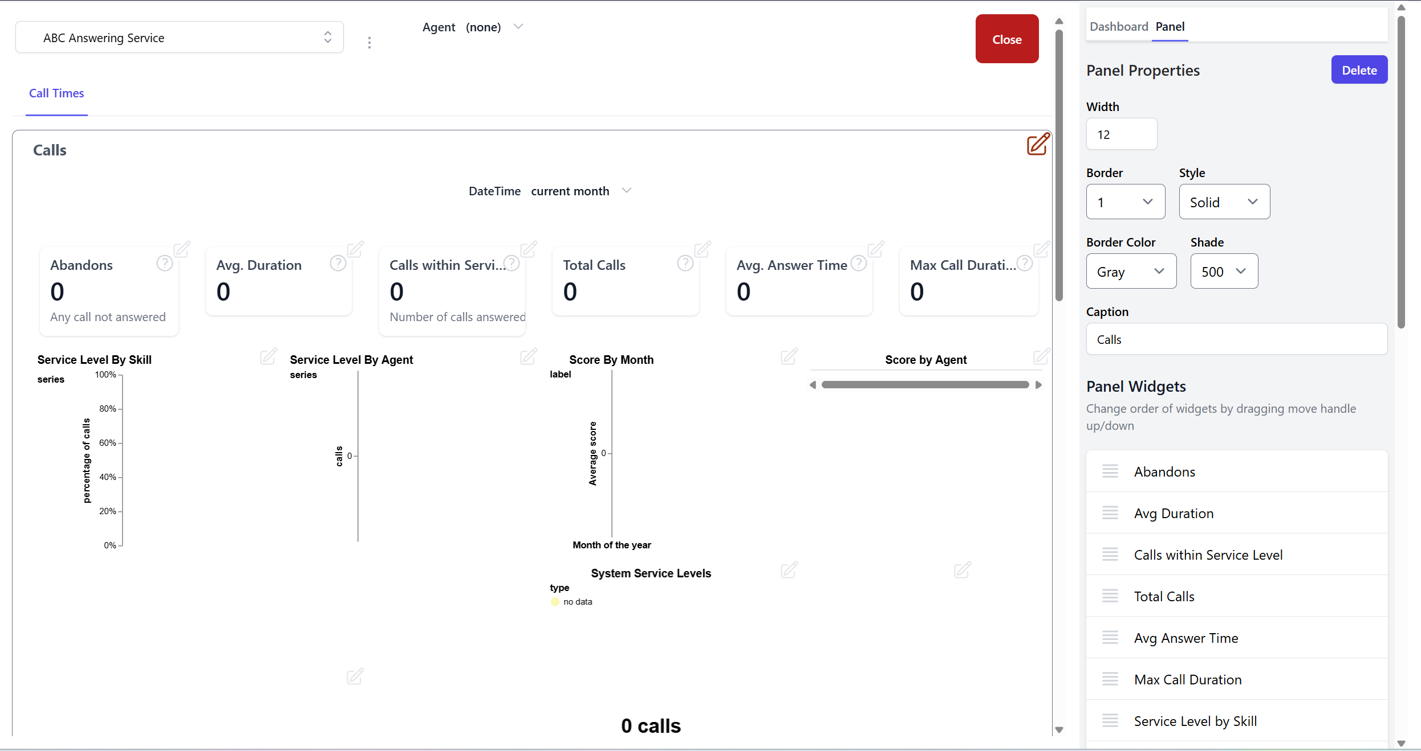

Slide 17
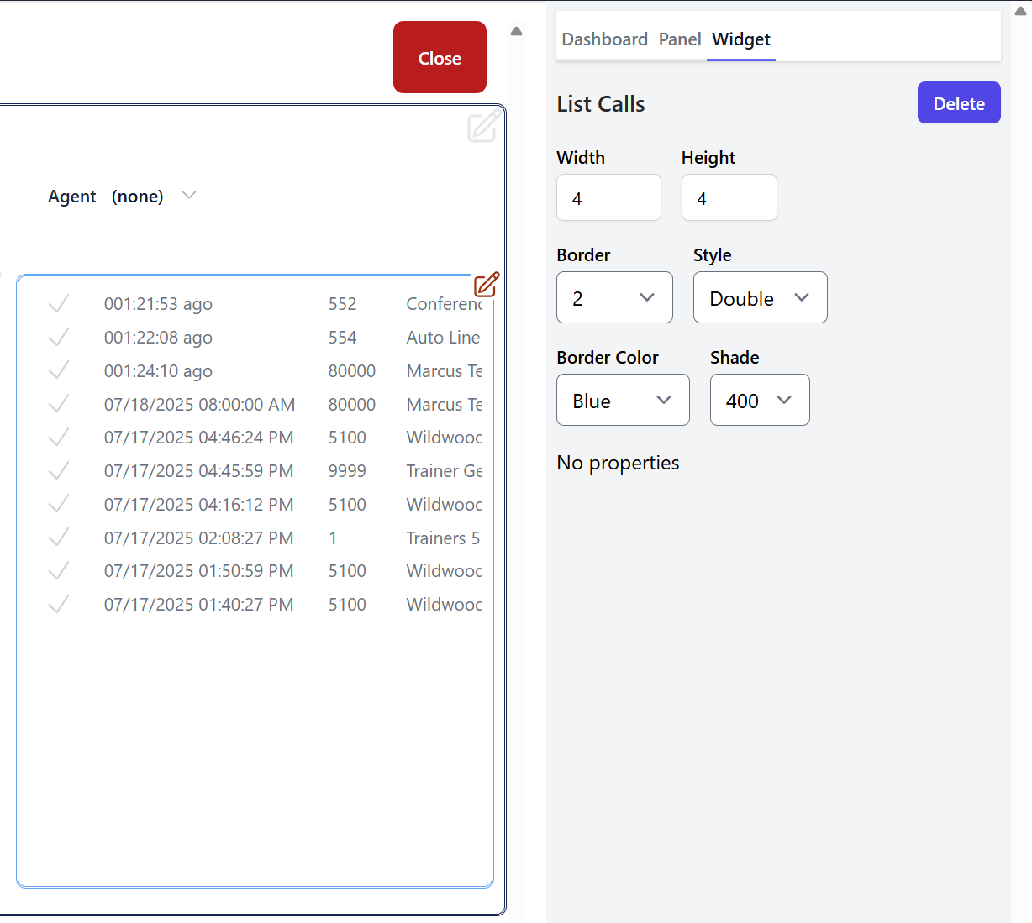
Editing Widgets
Similarly, you can edit widgets straight from the dashboard
Click the pencil icon and the sidebar will show up. From here, you can edit the visual styles for your widget

Slide 18
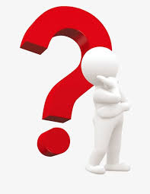
Useful Widgets
Abandon Time
System Service Level
Call Metrics by Client
Scores
Score Cards

Slide 19
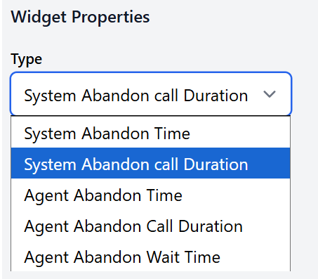
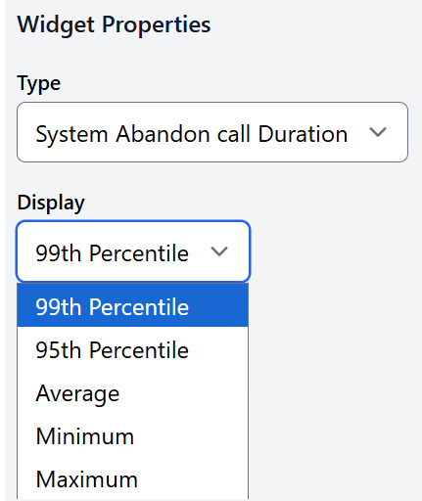
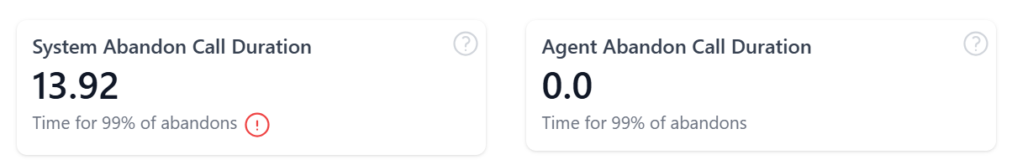
Widget – Abandon Time
Abandon Time
Display's the abandon time depending on filters and parameters that are specified
Because of this, it may be worth having two of the same widget, using Abandon time as an example, having one for System abandon time and the other for Agent abandon time.
Display will control how the data will be presented.

Slide 20
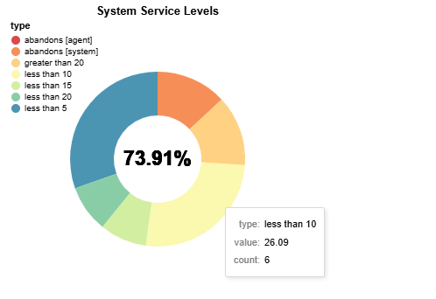
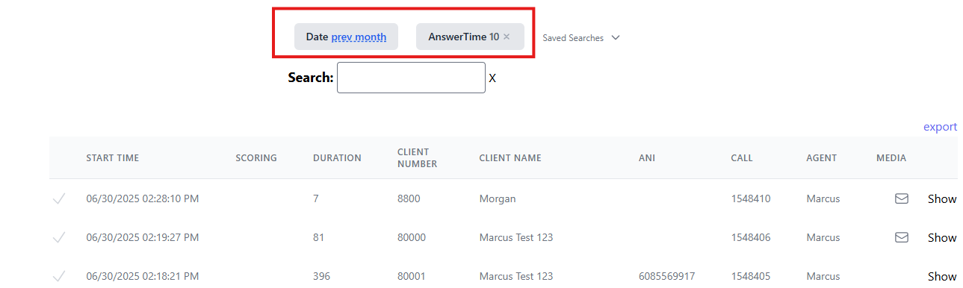
Widget – System Service Levels
System Service Levels
While there are not any "properties" for the Service Level widget, it is an interactive widget!
There are tool tips when your cursor is hovering over the pie chart
Clicking on any portions of the pie chart will direct you to the call log with filters already in place of these statistics

Slide 21
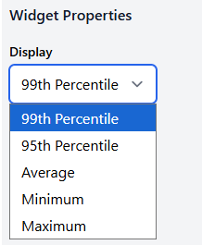
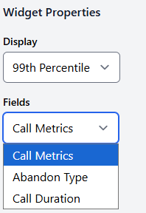
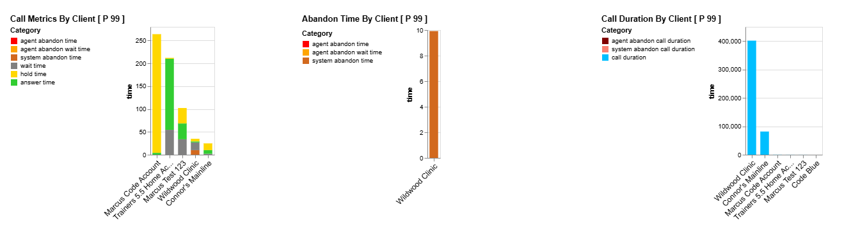
Widget – Call Metrics by Client
Call Metrics by Client
Displays calls from your top 20 Clients in which you received calls
There are tool tips when your cursor is hovering over the bar graph displaying a breakdown of information on calls coming into that client
Display properties
Fields properties
Clicking on any portions of the bar graph will direct you to the call log with filters already in place of these statistics

Slide 22
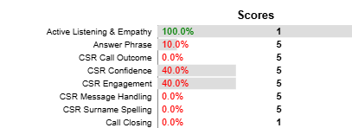

Widget - Scores
Scores
Displays averages on specific score elements from an Active Insights script(s)
The number on the right indicates the maximum amount that can be scored for that element
The percentages show the average percentage all the operators earned for these scores (assuming there are no filters other than date/time in place)
Hovering your cursor over the grey bar will give you additional information

Slide 23
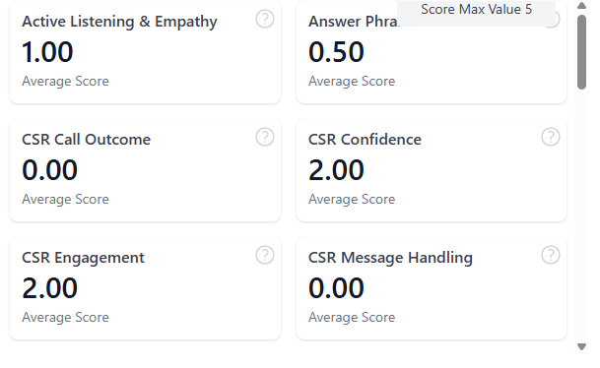
Widget – Score Cards
Score Cards
Displays the average score for each individual score that is possible to obtain
The little "?" Is a reminder for what the maximum score is for that score

Slide 24
Optimizing your data
Why should you care about optimizing your dashboards?
After all, if the data is present who cares how it's presented?
Let's look at a poor example of a dashboard to understand why.

Slide 25
Reordering Widgets
This panel has every widget possible enabled. It has too much information to be useful.
The information within is also organized poorly. It's hard to find what you're looking for.

Slide 26
Reordering Widgets
Look at how much you have to scroll to find what you're looking for.

Slide 27
Optimize your data
At the end of the day, Active Insights is an efficiency tool
Your dashboards should make your life easier, not harder
The most powerful dashboards will:
Have your data visible right when you open it
Keep information grouped in a way that makes sense to you.
You want information visible immediately. If you need to scroll to view everything, your dashboard is too big.

Slide 28
Optimizing default dashboards
Our defaults are designed to be modified!
Chances are, your screen resolution won't fit all the data on an Amtelco default dashboard
Trim your defaults of information you don't need and re-organize the most pertinent widgets to be on the top.
Tip: If there's a widget you only "sort-of" use, consider removing it. Screen clutter can often end up slowing you down!

Slide 29
Thank you for Attending!
Questions?

